Slide 1
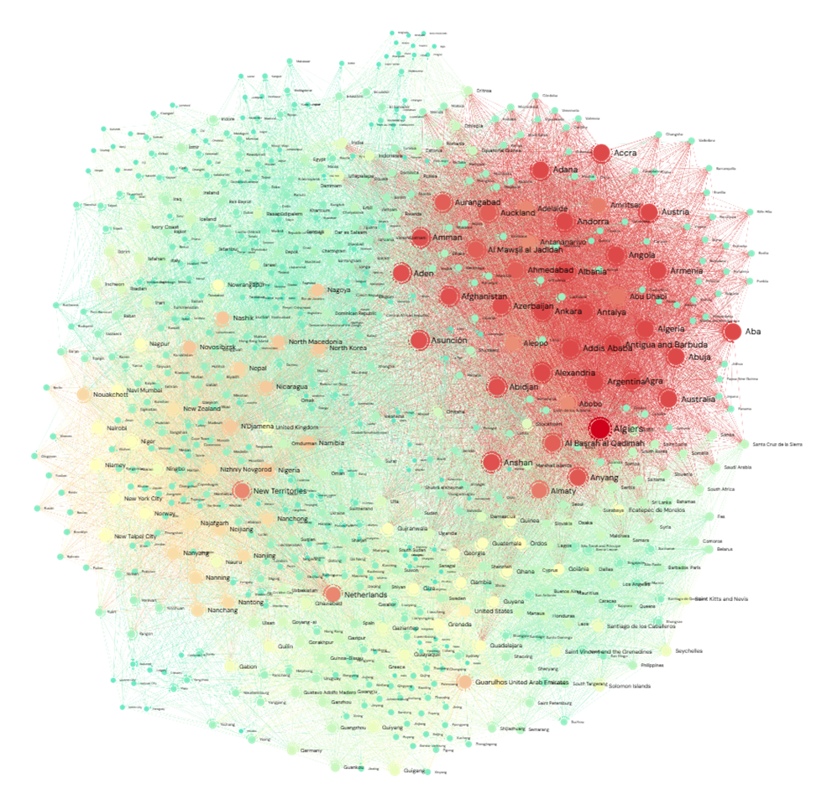
Node2Vec
Scalable Feature Learning for Networks

Slide 2
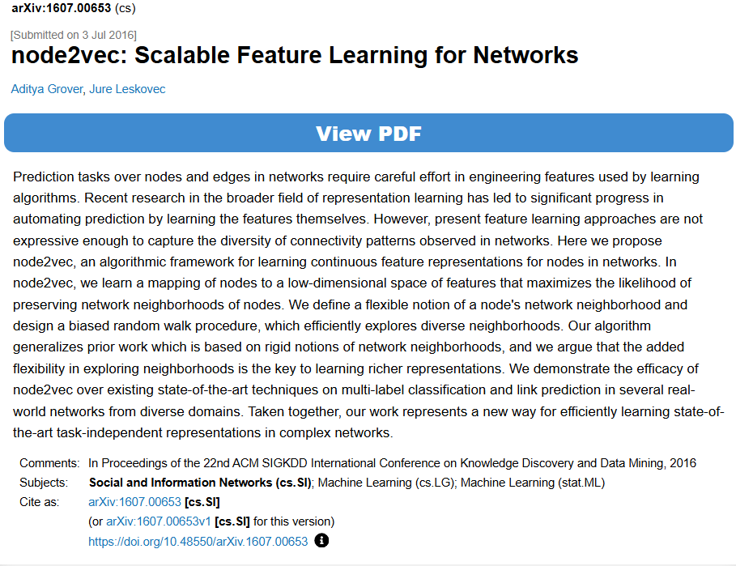
Paper snip

Slide 3
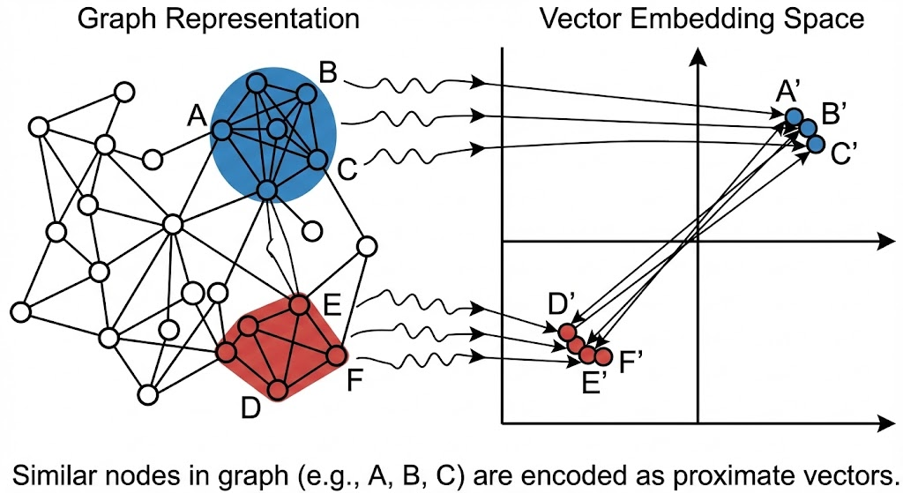
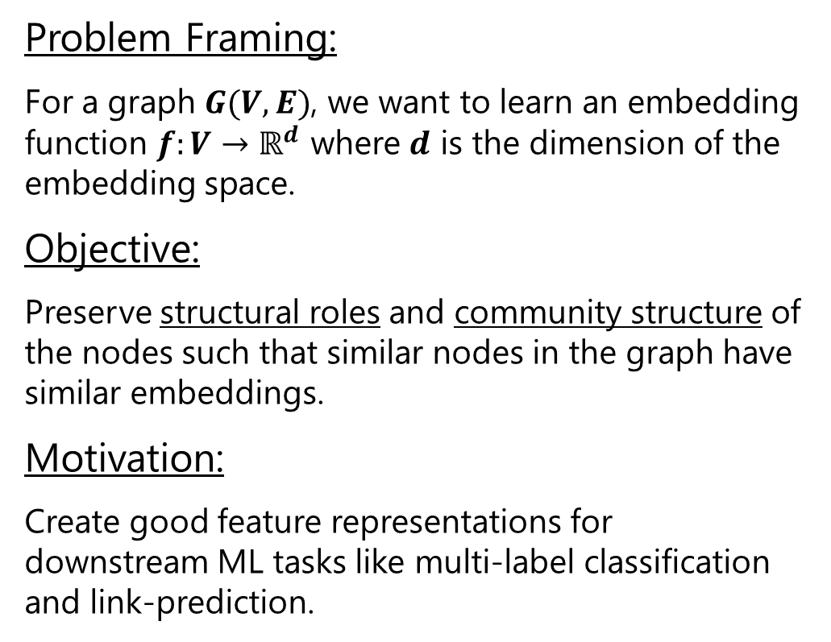
Problem, Objective and Motivation
Problem Framing:
For a graph $G(V, E)$, we want to learn an embedding function $f:V→ℝ^{d}$ where $d$ is the dimension of the embedding space.
Objective:
Preserve structural roles and community structure of the nodes such that similar nodes in the graph have similar embeddings.
Motivation:
Create good feature representations for downstream ML tasks like multi-label classification and link-prediction.

Slide 4
Limitations of Earlier Approaches
Previous approaches to feature learning were not expressive enough to capture the diversity of connectivity patterns based on structural equivalence and homophily of nodes in a network.
Hand engineered domain-specific features cannot generalize across different downstream tasks.
Classical approaches based on dimensionality reduction like PCA are expensive as they involve eigen decomposition of relevant matrices.
Other approaches inspired by the Word2Vec model provide no flexibility and rely on rigid node sampling strategies.

Slide 5
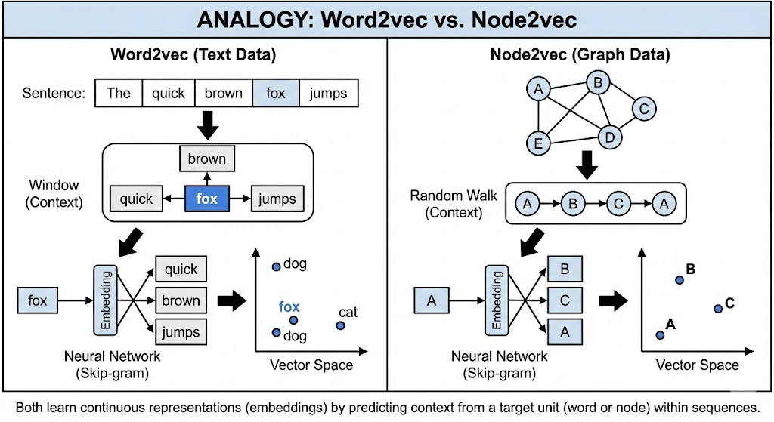
Analogy with Word2Vec
Word2Vec | Node2Vec
Words | Nodes
Sentence | Random Walk
Context Window | Node Neighbourhood
Document | Network
As in Word2Vec, similar words should appear within similar contexts, we extend the analogy by assuming that similar nodes exist in similar graph neighbourhoods.
We learn feature representations in a semi-supervised manner by optimizing the likelihood objective using SGD with Negative Sampling.
Since network structures are not linear in nature like text, we need a richer notion of neighbourhood rather than the immediate neighbours.

Slide 6
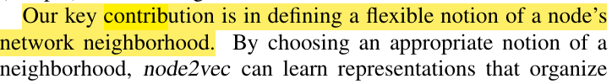
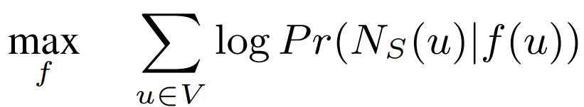
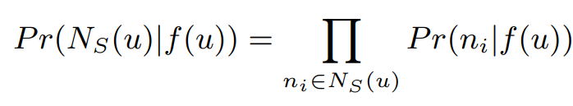
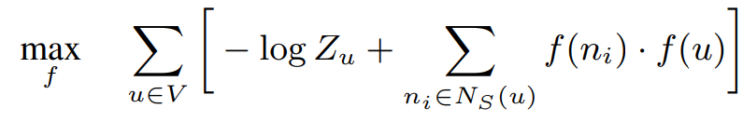
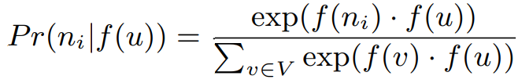
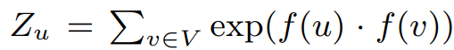
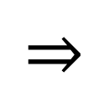
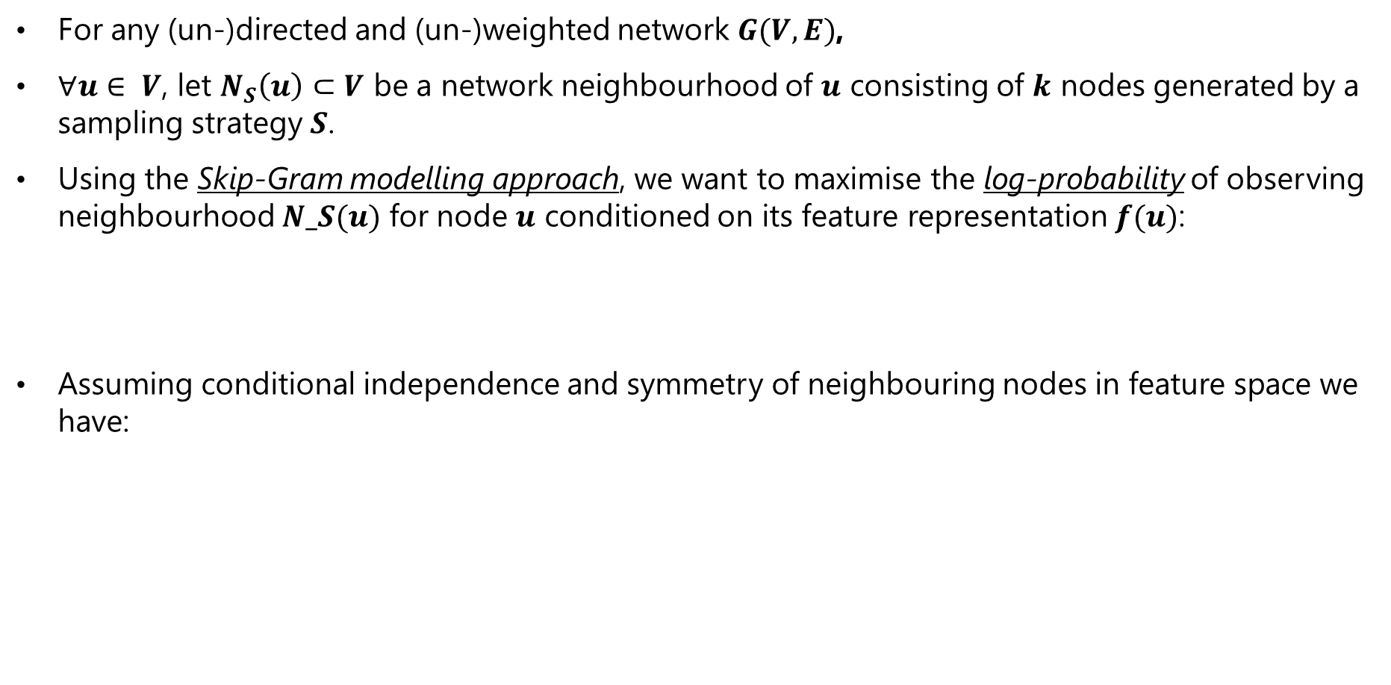
The Feature Learning Framework
For any (un-)directed and (un-)weighted network $G(V,E)$,
$∀u∈ V$, let $N_{S}\left(u\right)⊂V$ be a network neighbourhood of $u$ consisting of $k$ nodes generated by a sampling strategy $S$.
Using the Skip-Gram modelling approach, we want to maximise the log-probability of observing neighbourhood $N_S(u)$ for node $u$ conditioned on its feature representation $f(u)$:
Assuming conditional independence and symmetry of neighbouring nodes in feature space we have:
$$⇒$$
is the per node partition function approximated by using negative sampling.

Slide 7
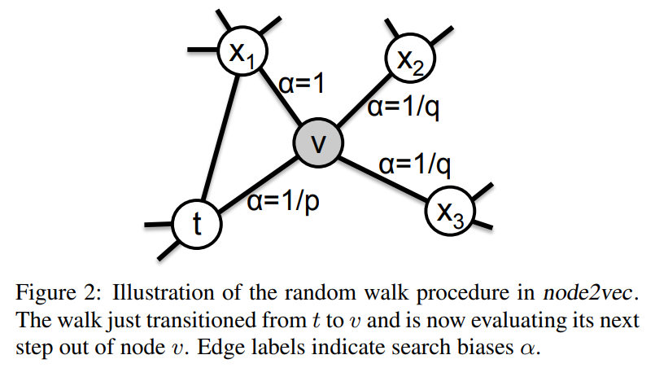
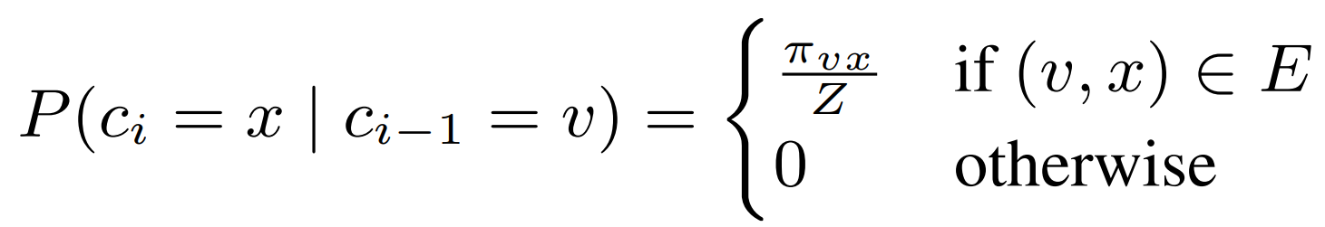
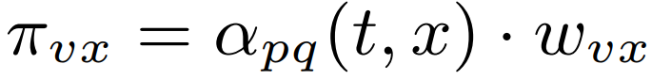
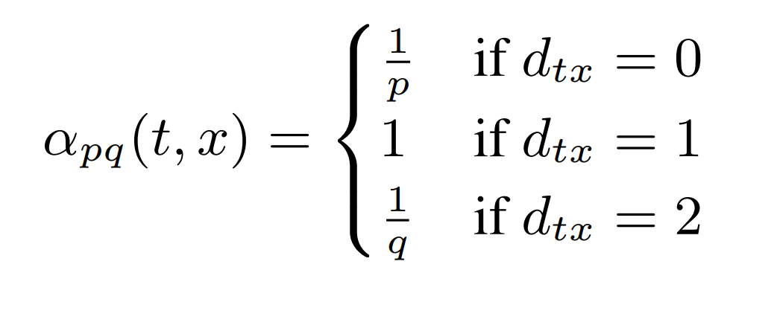
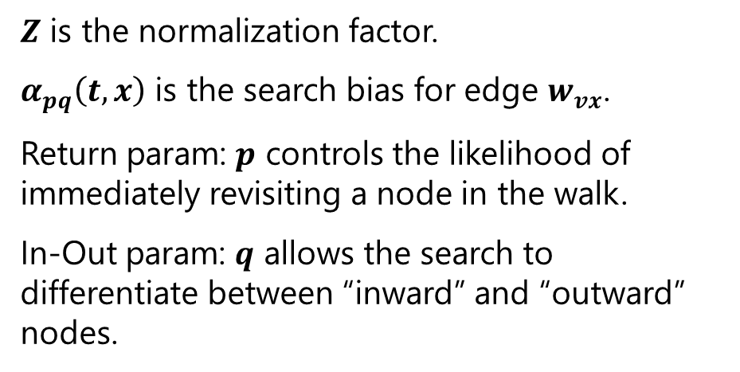
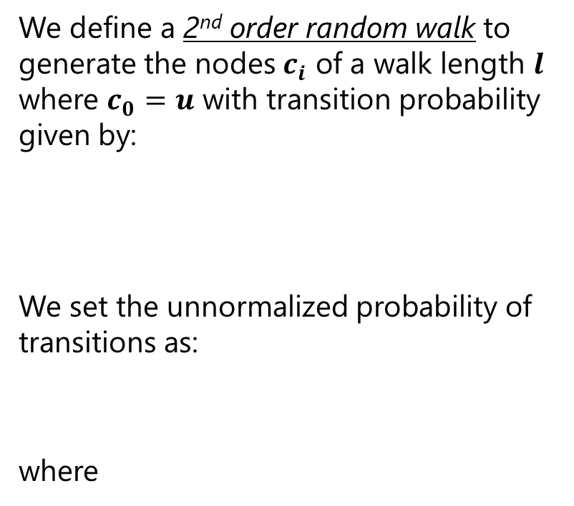
The Sampling Strategy $S$
We define a 2nd order random walk to generate the nodes $c_{i}$ of a walk length $l$ where $c_{0}=u$ with transition probability given by:
We set the unnormalized probability of transitions as:
where
$Z$ is the normalization factor.
$α_{pq}\left(t,x\right)$ is the search bias for edge $w_{vx}$.
Return param: $p$ controls the likelihood of immediately revisiting a node in the walk.
In-Out param: $q$ allows the search to differentiate between “inward” and “outward” nodes.

Slide 8
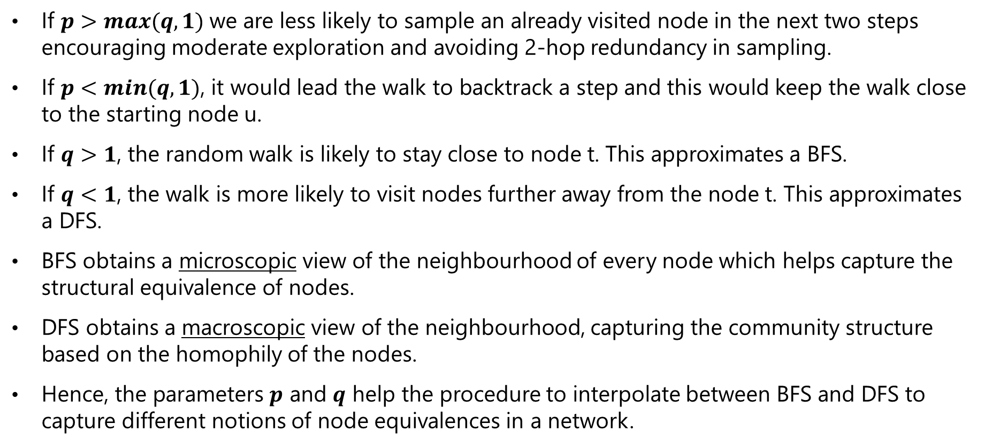
Smooth Interpolation of BFS and DFS
If $p>max⁡(q, 1)$we are less likely to sample an already visited node in the next two steps encouraging moderate exploration and avoiding 2-hop redundancy in sampling.
If $p<min⁡(q, 1)$, it would lead the walk to backtrack a step and this would keep the walk close to the starting node u.
If $q>1$, the random walk is likely to stay close to node t. This approximates a BFS.
If $q<1$, the walk is more likely to visit nodes further away from the node t. This approximates a DFS.
BFS obtains a microscopic view of the neighbourhood of every node which helps capture the structural equivalence of nodes.
DFS obtains a macroscopic view of the neighbourhood, capturing the community structure based on the homophily of the nodes.
Hence, the parameters $p$ and $q$ help the procedure to interpolate between BFS and DFS to capture different notions of node equivalences in a network.

Slide 9
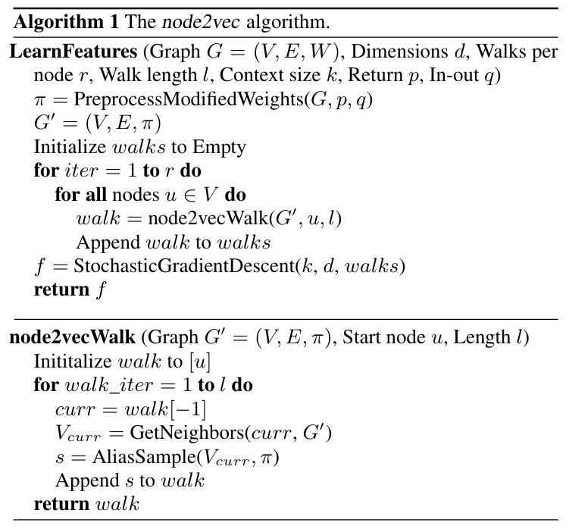
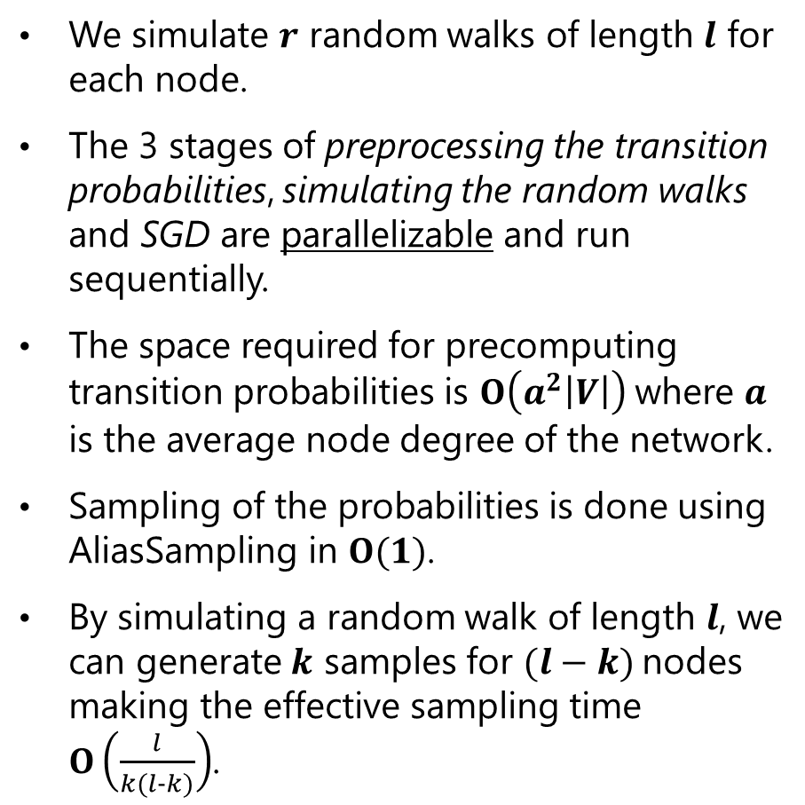
The node2vec Algo
We simulate $r$ random walks of length $l$ for each node.
The 3 stages of preprocessing the transition probabilities, simulating the random walks and SGD are parallelizable and run sequentially.
The space required for precomputing transition probabilities is $Ο\left(a^{2}\left|V\right|\right)$ where $a$ is the average node degree of the network.
Sampling of the probabilities is done using AliasSampling in $Ο(1)$.
By simulating a random walk of length $l$, we can generate $k$ samples for $(l−k)$nodes making the effective sampling time $Ο\left(\frac{l}{k(l-k)}\right)$.

Slide 10
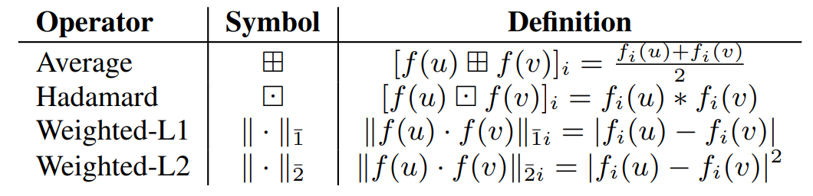
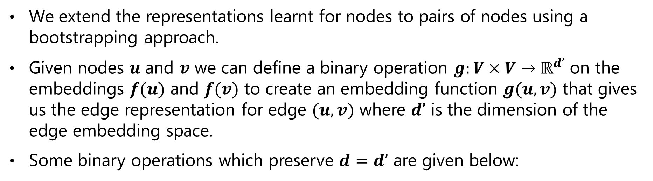
Learning Edge Representations
We extend the representations learnt for nodes to pairs of nodes using a bootstrapping approach.
Given nodes $u$ and $v$ we can define a binary operation $g:V×V{→ℝ}^{d’}$ on the embeddings $f(u)$ and $f(v)$ to create an embedding function $g(u,v)$ that gives us the edge representation for edge $(u,v)$ where $d’$ is the dimension of the edge embedding space.
Some binary operations which preserve $d=d’$ are given below:

Slide 11
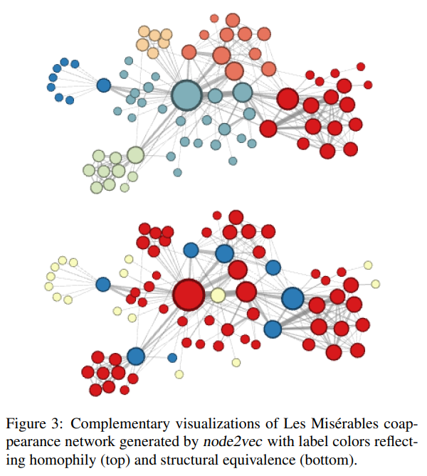
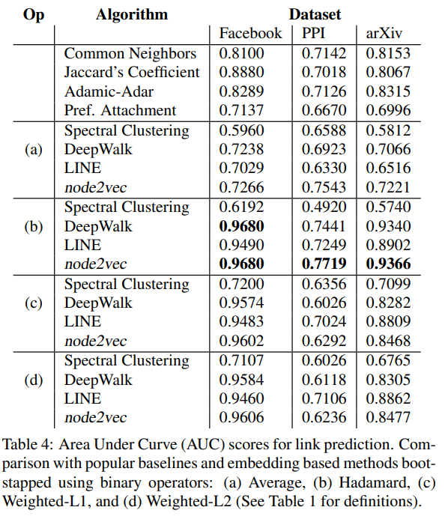
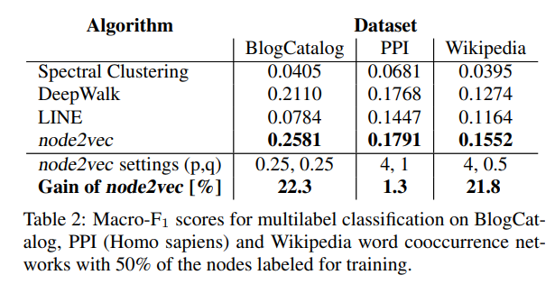
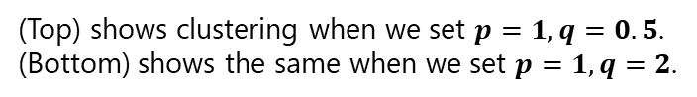
Experiments and Results
(Top) shows clustering when we set $p=1, q=0.5$.
(Bottom) shows the same when we set $p=1, q=2$.

Slide 12
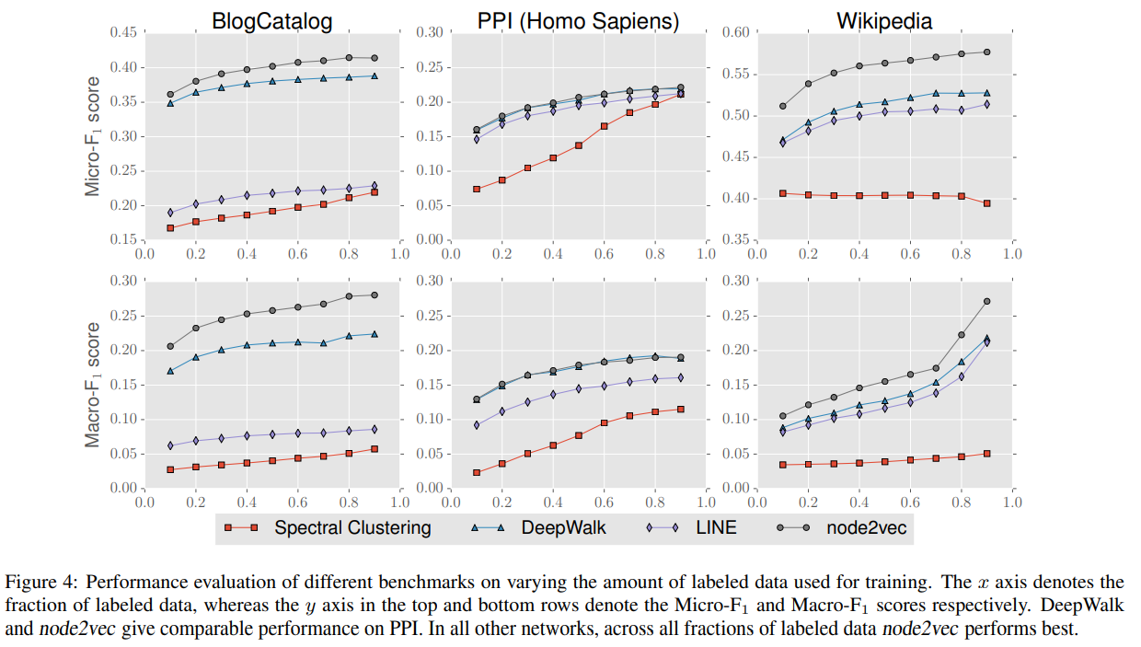
Experiments and Results

Slide 13
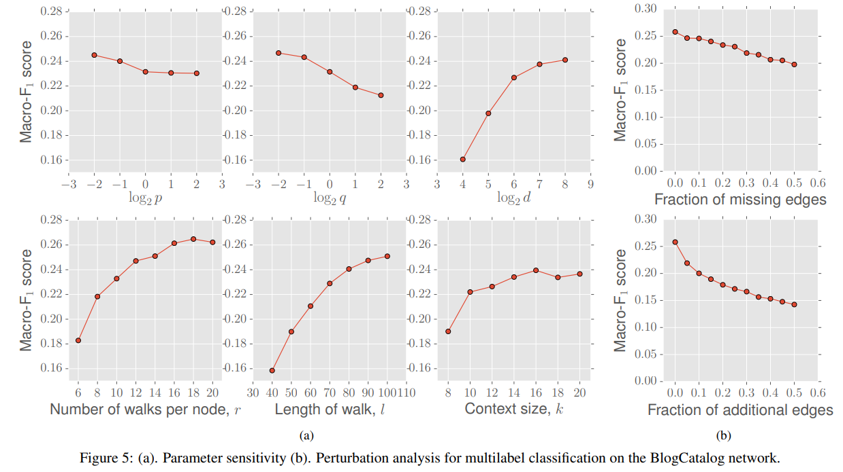
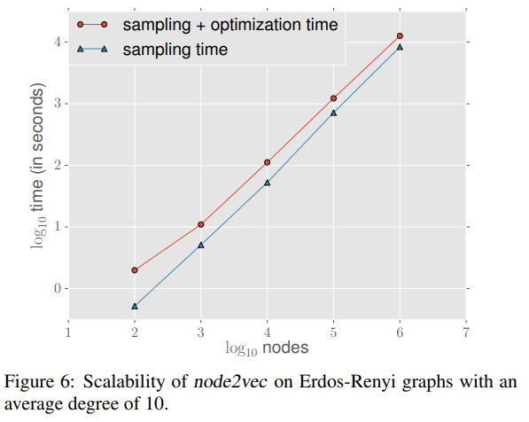
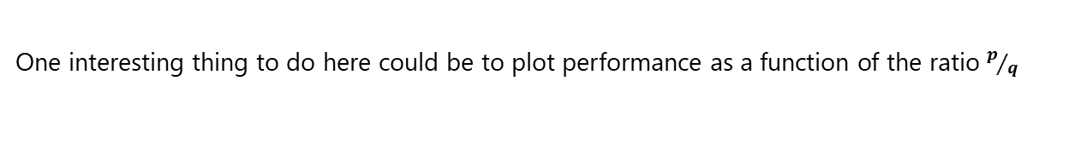
Parameter Sensitivity, Perturbations, Scalability
One interesting thing to do here could be to plot performance as a function of the ratio $p/q$

Slide 14
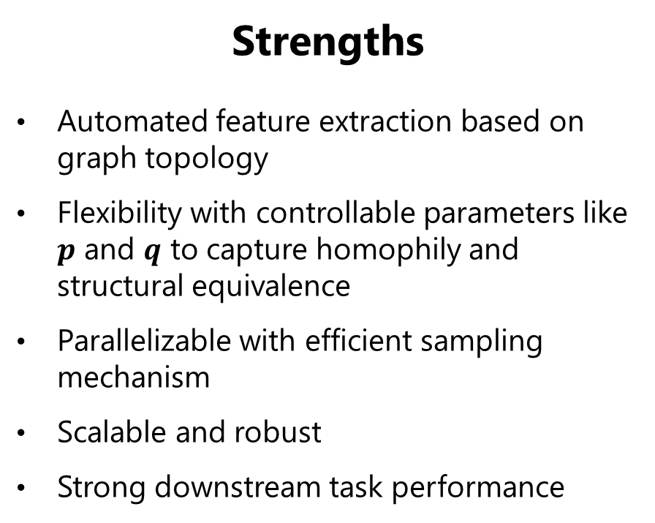
Strengths & Weaknesses
Strengths
Automated feature extraction based on graph topology
Flexibility with controllable parameters like $p$ and $q$ to capture homophily and structural equivalence
Parallelizable with efficient sampling mechanism
Scalable and robust
Strong downstream task performance
Weaknesses
Cannot take into account node features if available (GNNs can)
Cannot handle heterogenous graphs (extensions like Het-node2vec exist)
Cannot embed new nodes (OOV problem)
Cannot handle dynamic graphs (versions like node2vec-online exist)

Slide 15
Things to do next:
Study the performance of node2vec as a function of the ratio p/q.
Study node2vec extensions for heterogenous graphs and dynamic graphs.
Study GNNs and attention mechanisms in GNNs.

Slide 16
References
Grover, A. and Leskovec, J. 2016. node2vec: Scalable Feature Learning for Networks. In Proceedings of the 22nd ACM SIGKDD International Conference on Knowledge Discovery and Data Mining (KDD '16). Association for Computing Machinery, New York, NY, USA, 855–864. DOI: https://doi.org/10.1145/2939672.2939754.
Tomaz Bratanic: Complete guide to understanding Node2Vec algorithm on Medium. (https://medium.com/data-science/complete-guide-to-understanding-node2vec-algorithm-4e9a35e5d147)
OpenAI. (2025). ChatGPT (Dec 25 version) [Large language model]. (https://chat.openai.com/chat).
Google DeepMind. (2025). Nano Banana Pro (Dec 25 version) [Image generation model] (https://gemini.google.com/)

Slide 17
THANKS!
Thanks PreCog @ IIIT-Hyd for providing this opportunity.
I learnt a lot and had fun!

